Slide 1
Mobile Safety Project
March 2,2017

Slide 2
Part 1- Literature review
Smoke word
Double propagation
Lexicon Builder- poliarity
Framework to generate a domain lexicon – Senti WordNet

Slide 3
Take away:
Use existing lexicon, try to find statistically significant features
Potential lexicon:
-WWW Lexicon for each tag
-Domain lexicon for each category, such as “Violence”, “Sexual”
-Create our own lexicon
-Word Net

Slide 4
Part 2- Project Outline
Testing
Matched apps
Model Building
Similarity
Semantic approach
(Word Net weight)
Check KNN
Similarity methods:
-Overlap
-Jaccard
-Cosine
Validation
Training
(Benchmark)
(Combine?)
Mturk
Non-Matched apps
Suspicious
Apps
Evaluation
Intensity approach
ANOVA
Chi-square
Testing
Matched apps

Slide 5
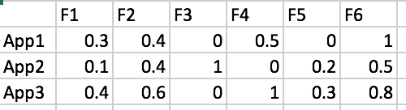
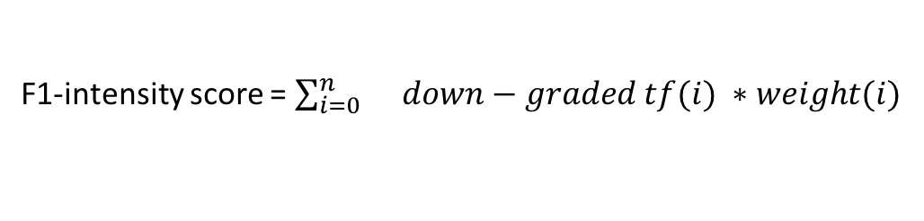
Intensity-score features
Tags: from WWW paper
No. | Features | Contents include | Tags (weak) | Tags (strong)
F1 | Violence | Fantasy Violence, Realistic violence, horror themes, comic mischeif (new), blood | A1(5) A2 (5) B1(5) C1(5) | B2(10) C2(10)
F2 | Sex | Sexual content, Nudity, suggestive themes | D1(5) | D2(10) E1,E2(10)
F3 | Offensive | Offensive language, profanity or crude humor | F1(5) | F2(10)
F4 | DAT | Reference of drug alcohol tobacco | G1(5) | G2(10)
F5 | Gambling | Simulated gambling | H1(5) | H2(10)
F6 | Direct warning | 21+ years old only… |  | If mention (10)
F1-intensity score = $\sum_{i=0}^{n}{}down−graded tf(i) ∗weight(i)$
F2-intensity score
1.Find Lexicon for each feature
Intensity-score matrix for each app
…
F6
2. Adjust weight for each term
Similarity
Notes:
-lexicon: 1,1,1,1,1 v.s.

Slide 6
1. To find seed Lexicon for each Feature
Count frequency for each word across each feature
Tokens_distribution.xlsx
V: Violence, S: Sex, L: Language, A: Alcohol Drug Tobacco, G: Gambling
V_freq(i): total frequency of the word(i), if “rating reason” of the app has tag in Violence Feature
V_freq_norm(i): V_freq(i)/sum(V_freq) *1000000
%V(i) = V_freq(i) / Total_freq(i)
%V_norm(i) = V_freq_norm(i) / Total_freq_norm(i)
3. Sort by each feature
4. Pick seed lexicon by human expert
If a word has a very high frequency in feature V, and has low frequency in other features, the word should be put into lexicon V.

Slide 7
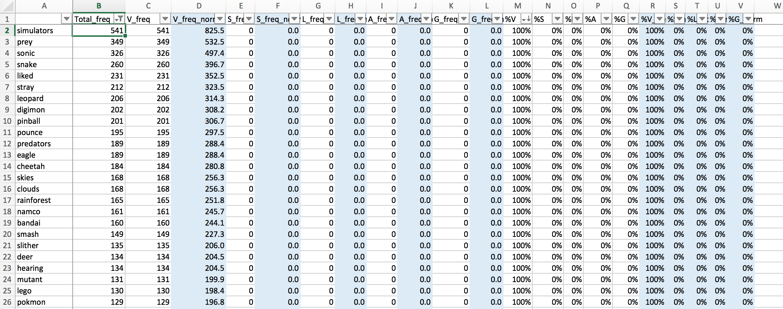
Sort by: Total_freq, %V
Words only appear in “Violence” : %V = %100
Should put into “Violence” Lexicon

Slide 8
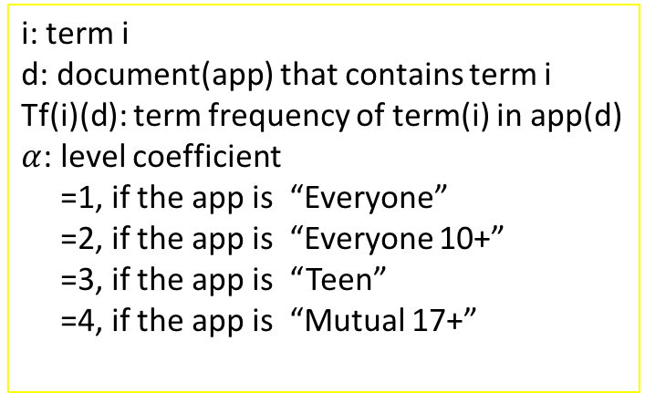
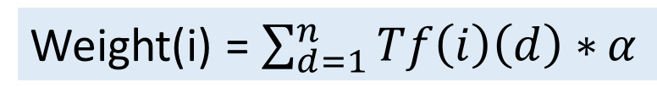
2. To find the weight of each term in Lexicon
Weight(i) = $\sum_{d=1}^{n}{Tf\left(i\right)\left(d\right)∗}α$
i: term i
d: document(app) that contains term i
Tf(i)(d): term frequency of term(i) in app(d)
$α$: level coefficient
=1, if the app is “Everyone”
=2, if the app is “Everyone 10+”
=3, if the app is “Teen”
=4, if the app is “Mutual 17+”
Weight don’t need to be to detail, overfitting problem
Every feature 2 parts.

Slide 9

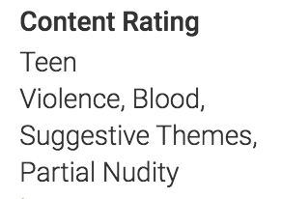
Question 1:
1. One app has multiple tags, but one word only has relationship to one tag. Using the method above, frequency of such word will be counted in multiple tags, even though it has no relationship with the tag.
Word:
Frequency:
“Kill”
[‘Violence’] +1
[‘Sex’] +1
https://play.google.com/store/apps/details?id=com.gamevilusa.dungeonlink.android.google.global.normal
“Kill” has nothing to do with Sex

Slide 10
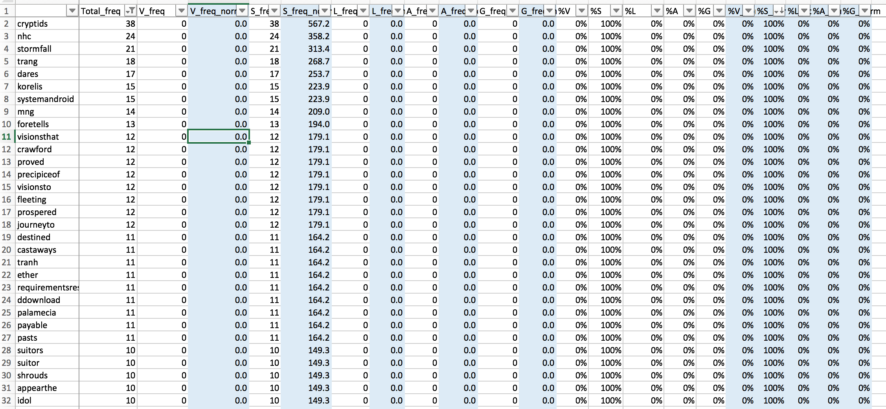
Question 2:
Weird signs, not a word
Top “Sex” words

Slide 11
To-dos:
Crawl Google Play..
Matching
Build Lexicon

